Slide 1
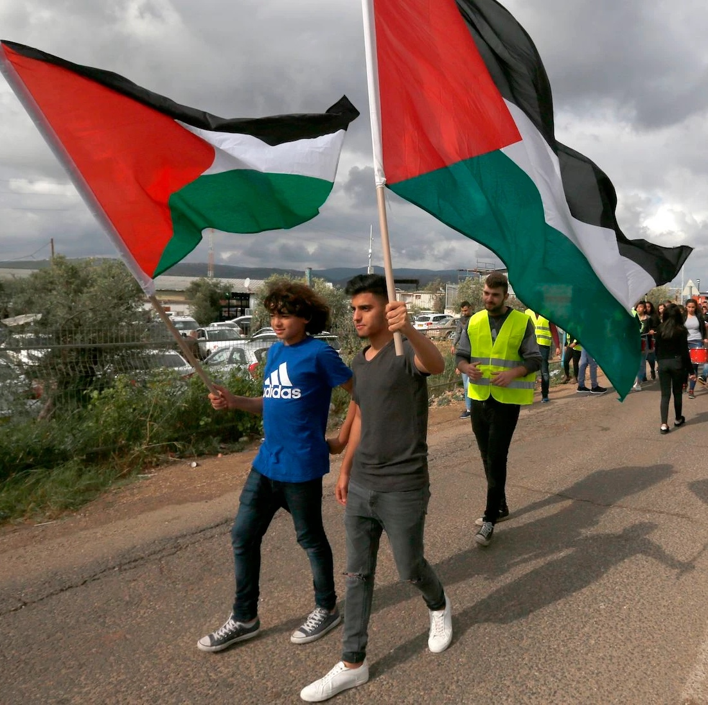
How does life differ for Palestinians and Israelis inside Israel?
Lesson 18

Slide 2
Learning objectives
By the end of this lesson, you should be able to:
Describe the population of Israel
Explain why some Palestinians live in Israel
Explain how life differs for Palestinians and Israelis inside Israel

Slide 3
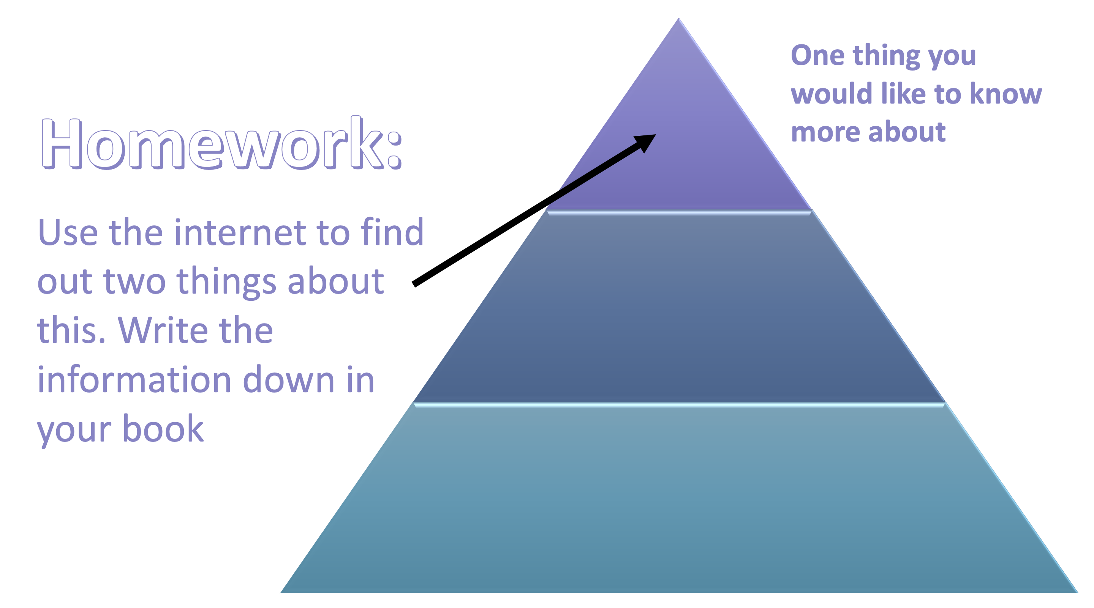
Starter activity
Share the results of your homework with the person sitting next to you:
What did you want to know more about?
What did you find out?
Did anything surprise you? Why?

Slide 4
Whole class discussion: what have you learnt from the person sitting next to you?

Slide 5
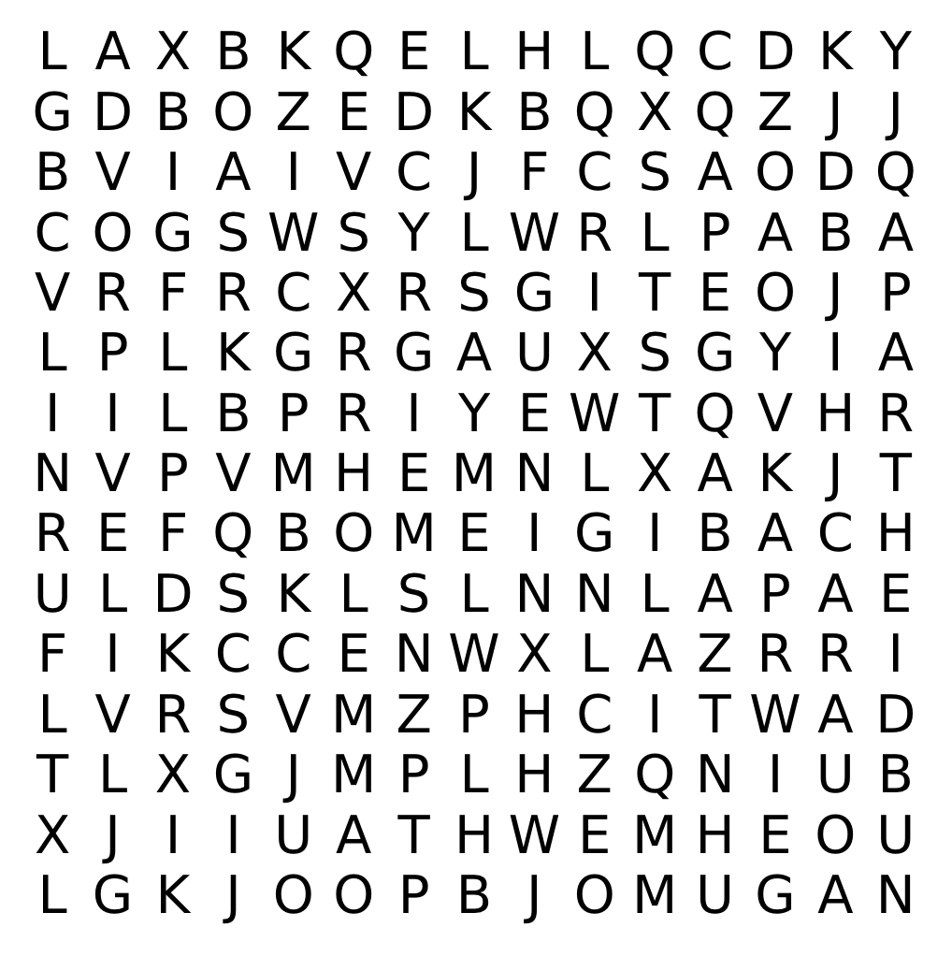
18a. Keywords wordsearch Can you find the keywords and match them to the definition below?
Discrimination
Green Line
Israeli Arab
Apartheid
__________: a policy or system of separation based on race
__________: the unfair treatment of someone based on their race, age or another characteristic
__________: a Palestinian who lives in Israel
__________: the border between Israel, Egypt, Jordan, Lebanon and Syria after the Arab-Israeli War of 1948

Slide 6
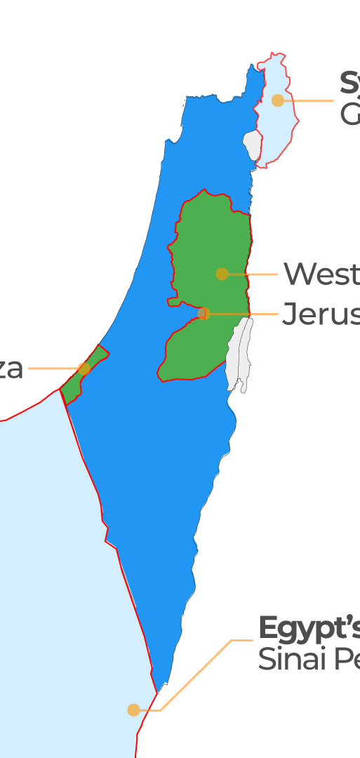
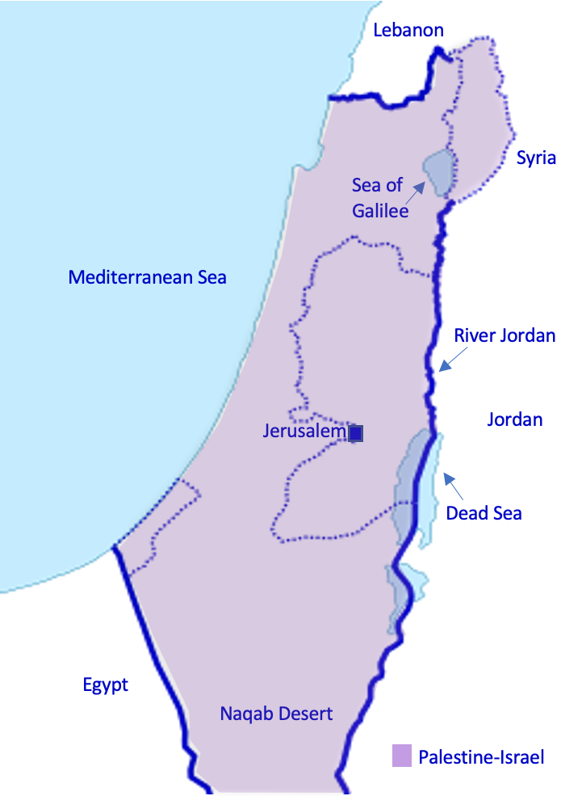
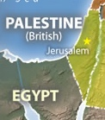
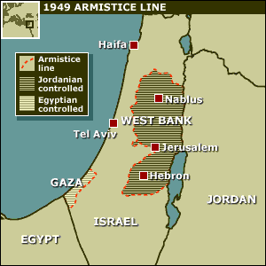
What do we mean by Israel?
Since the early 1900s, the map of Palestine-Israel has shifted…
Can you locate Haifa on these maps?
Historically, has Haifa been in Palestine or Israel?
Haifa is an example of a place in Israel with a mixed Palestinian and Israeli population
Palestine-Israel
pre-1918
British Mandate
1918-1948
After the 1948 Arab-Israeli war
After 1967

Slide 7
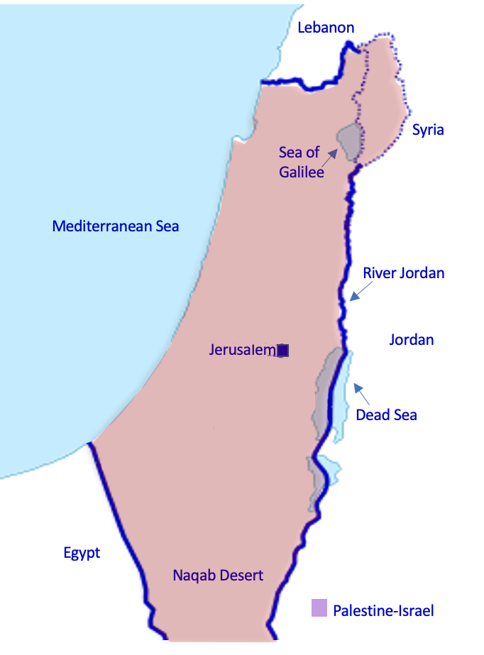
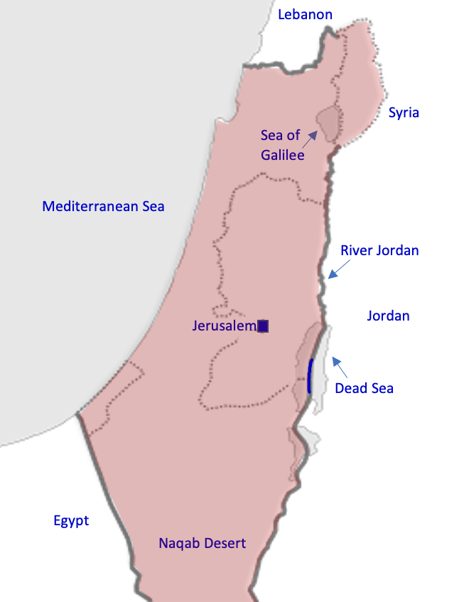
18b. Israel’s borders today With the person sitting next to you, use your existing knowledge to draw Israel’s borders onto this map of Palestine-Israel
West Bank
Gaza
Palestine-Israel
pre-1918
After the 1948 Arab-Israeli war
British Mandate
1918-1948
After 1967
TODAY
Extension! Fill in the 4 blanks on the map using these labels: Lebanon, Egypt, Jordan, Syria

Slide 8
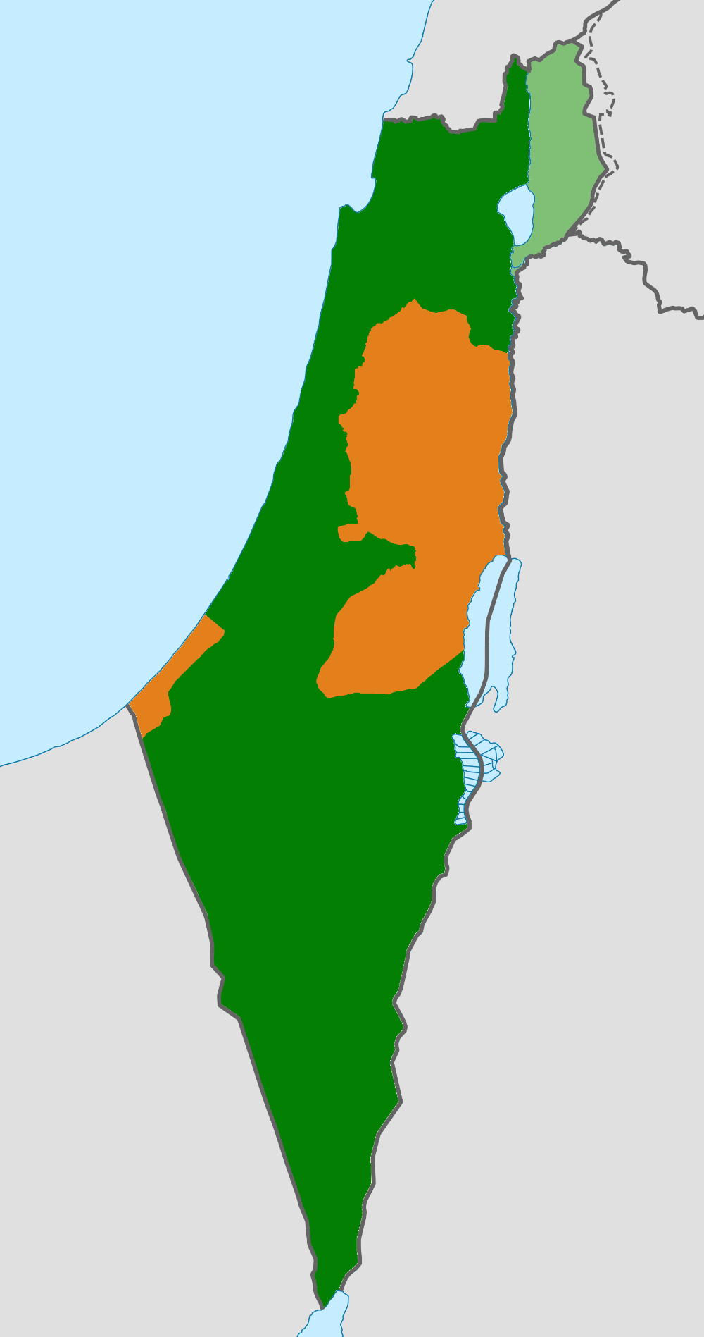
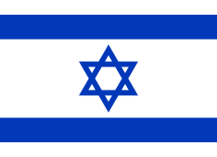
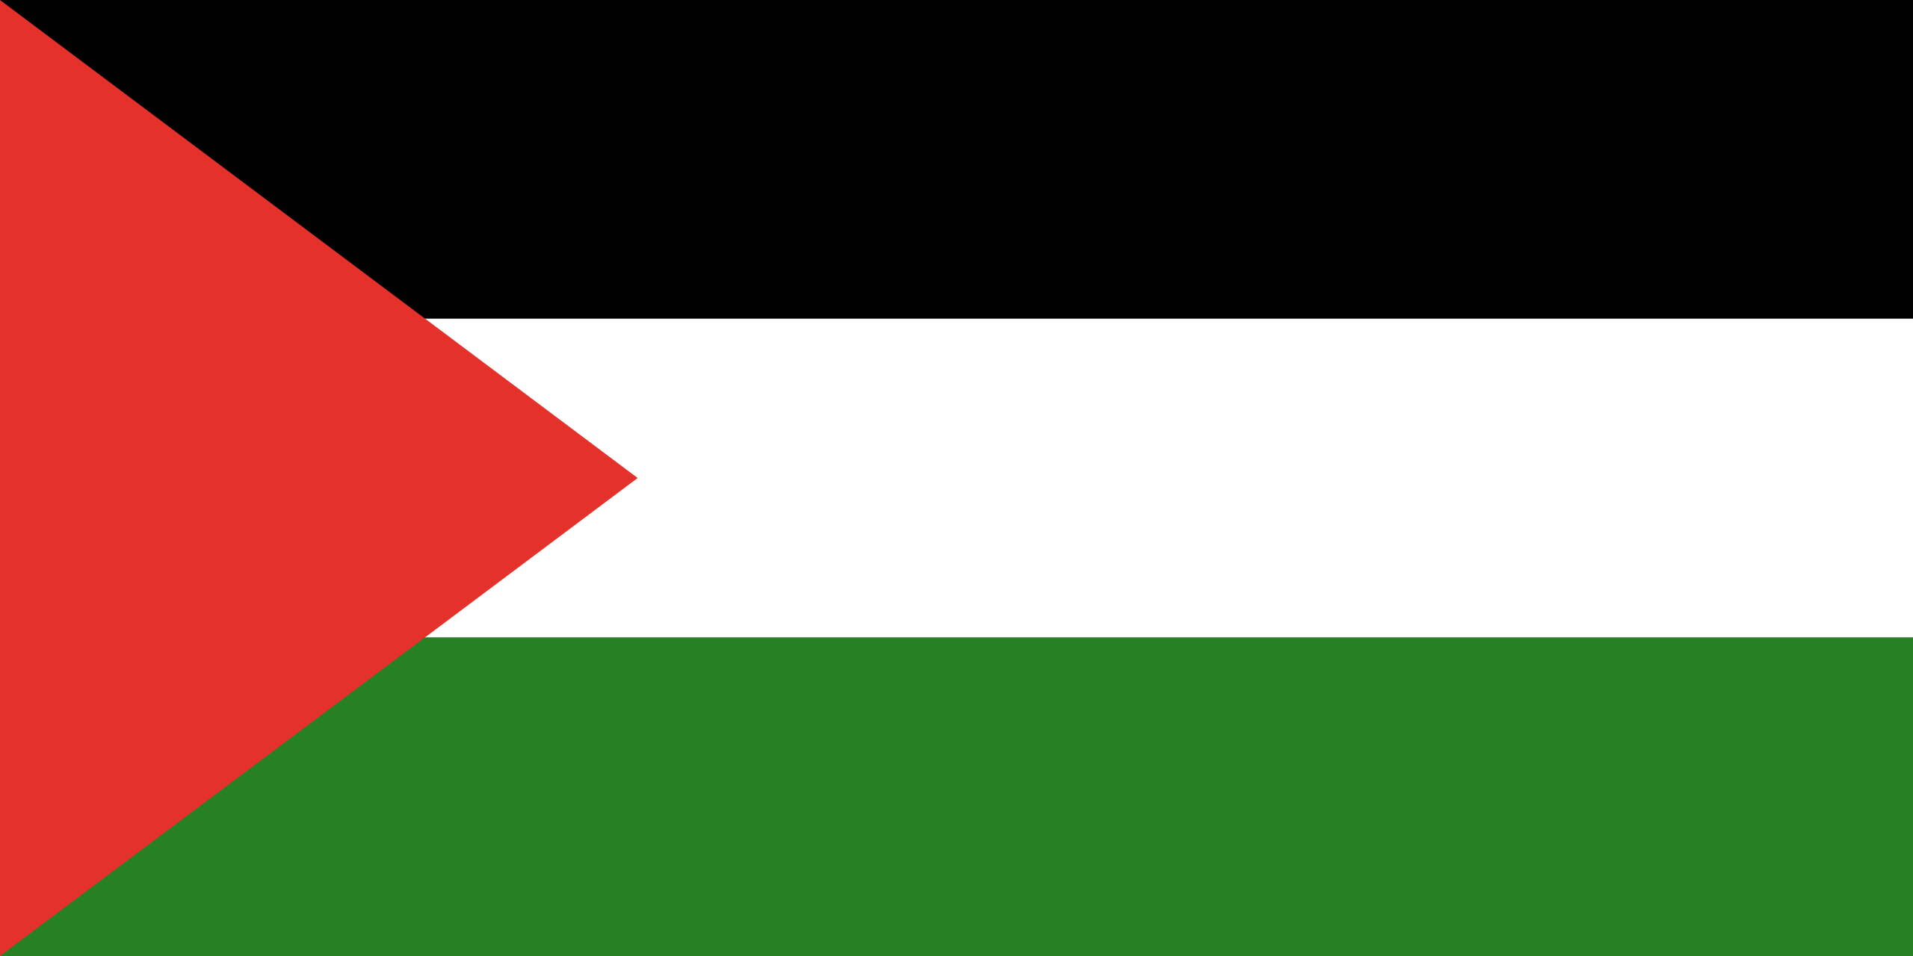
18c. Palestine-Israel today:
What country is orange?
The West Bank
Israel
Gaza
What country is green?
Palestine (illegally occupied by Israel)
What are the orange areas called?
Stick this sheet into your book

Slide 9
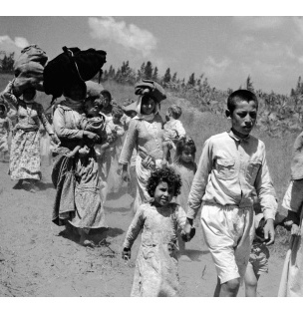
The population of Israel
Palestinians fleeing their homes during the Nakba of 1948
9 million people live in Israel
80% are Israeli
20% are Palestinian
Why are there Palestinians living in Israel?
Before 1948, what we now call Israel was all Palestine. In the Nakba of 1948, 750,000 Palestinians were forced to leave their homes, but some Palestinians remained in the new state of Israel
The Palestinians who live in Israel are sometimes referred to as “Israeli Arabs”, but many do not like this as it denies their Palestinian identity
Palestine-Israel
pre-1918

Slide 10
18d. Can you match green with blue?
A term used to describe Palestinians who live in Israel
9 million
Israelis living in Israel
7.2 million
Palestinians living in Israel
1.8 million
The population of Israel
Arabic for “catastrophe”, when 750,000 Palestinians (half of the Palestinian population) were forced to leave their homes and became refugees in 1948
Nakba
“Israeli Arab”

Slide 11
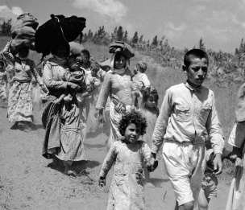
Discuss in pairs: what can you remember about the Nakba?
The Nakba was an example of ethnic cleansing: the systematic forced removal of an ethnic, racial or religious group (the Palestinians) from a particular area (Palestine)
It involved large-scale attacks aimed at expelling Palestinians from their towns and villages to build a future Jewish state
530 Palestinian villages and cities were destroyed
15,000 Palestinians were killed in a series of mass atrocities, including over 70 massacres
750,000 Palestinians (half of the Palestinian population) were forced to leave their homes and became refugees

Slide 12
18e. Palestinians in Israel
Life for Palestinians in Israel
Use the information below to create a spider diagram of life for Palestinians in Israel. Consider grouping the information into themes, for example ‘legal’, ‘economic’ & ‘social’ aspects of life
Under Israeli policies, Palestinians living in Israel live separate lives to Israelis. They are treated legally, politically, economically and socially as second-class citizens.
Israel maintains over 65 laws that discriminate against Palestinians.
Since 2018, Arabic has been removed as an official language of Israel.
Palestinians in Israel have poor access to education, jobs and services. They face discrimination in these areas, including health. Palestinians make up 20% of the population of Israel, but they only receive 1.7% of the budget for local councils.
Palestinians face significant disadvantages when it comes to housing, construction and land development.
This makes life for Palestinians in Israel very difficult.
Extension question: is this fair? Explain your answer

Slide 13
Whilst we watch the first few minutes of this video, make notes on the following question in your book:
What is it like to be Palestinian in Israel?
https://www.youtube.com/watch?v=8RVoPZPKxLY

Slide 14
Use your spider diagram and notes from the video to discuss this question in small groups: What is it like to be Palestinian in Israel?
Working individually now, answer this question in your book.

Slide 15
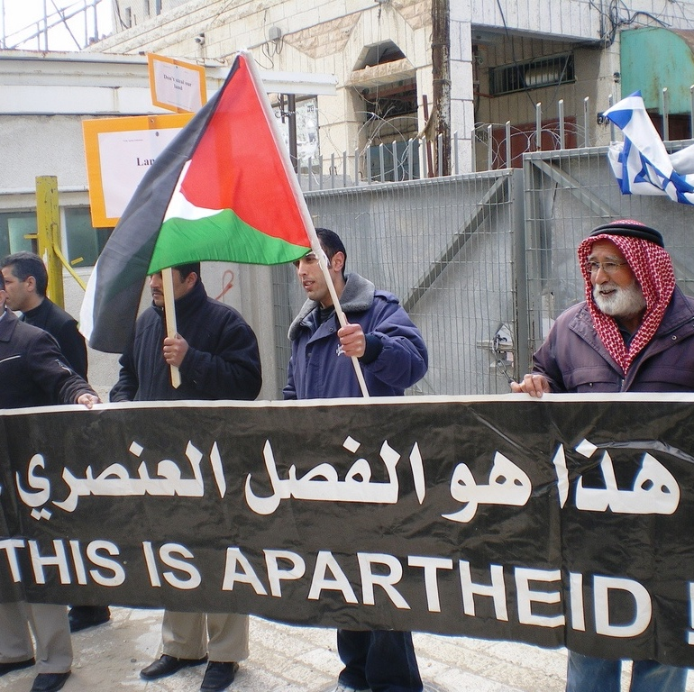
Apartheid
Apartheid is usually associated with discrimination in South Africa but it is also used to describe Israeli policy towards Palestinians
In 2021, international NGO Human Rights Watch and Israeli NGO B’Tselem declared that Israel is committing the crime of apartheid

Slide 16
As you watch this video, think about these questions:
1.What is apartheid?
2.In what ways is Israel committing apartheid?
https://www.youtube.com/watch?time_continue=180&v=6TLe4J7Dvd0&feature=emb_logo

Slide 18
Some Israelis are speaking out against Israeli occupation and apartheid…
Why is this important?
https://www.youtube.com/watch?v=7FoRt7jkvCU&feature=emb_logo

Slide 19
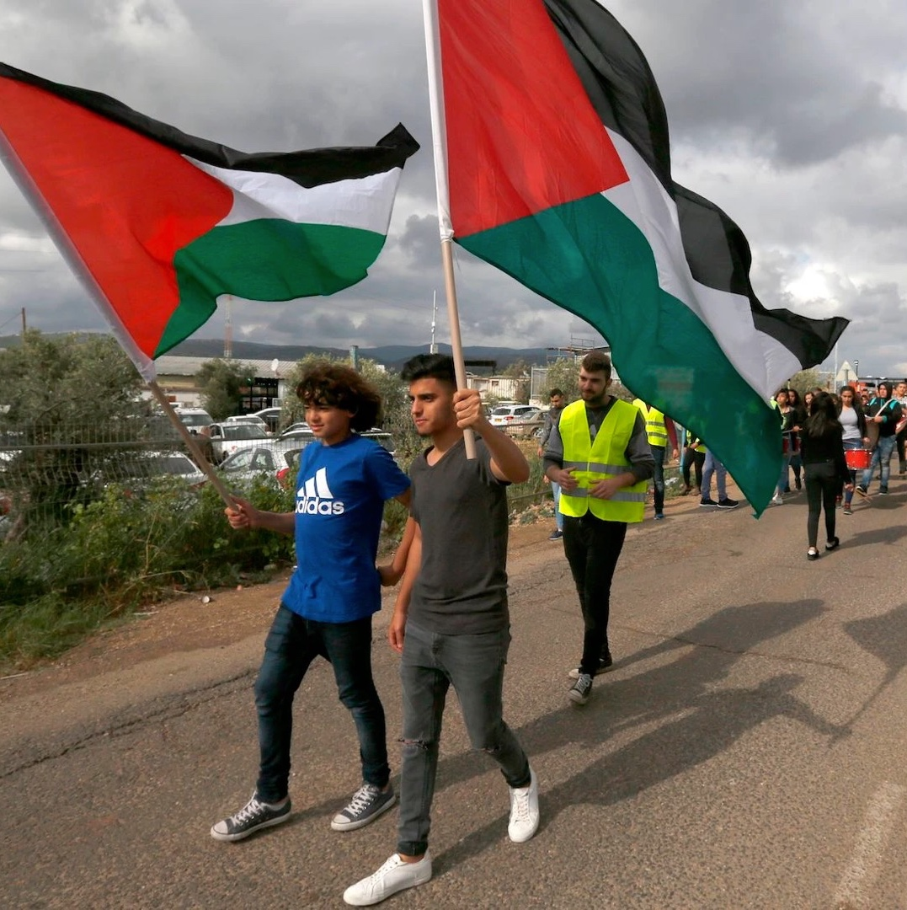
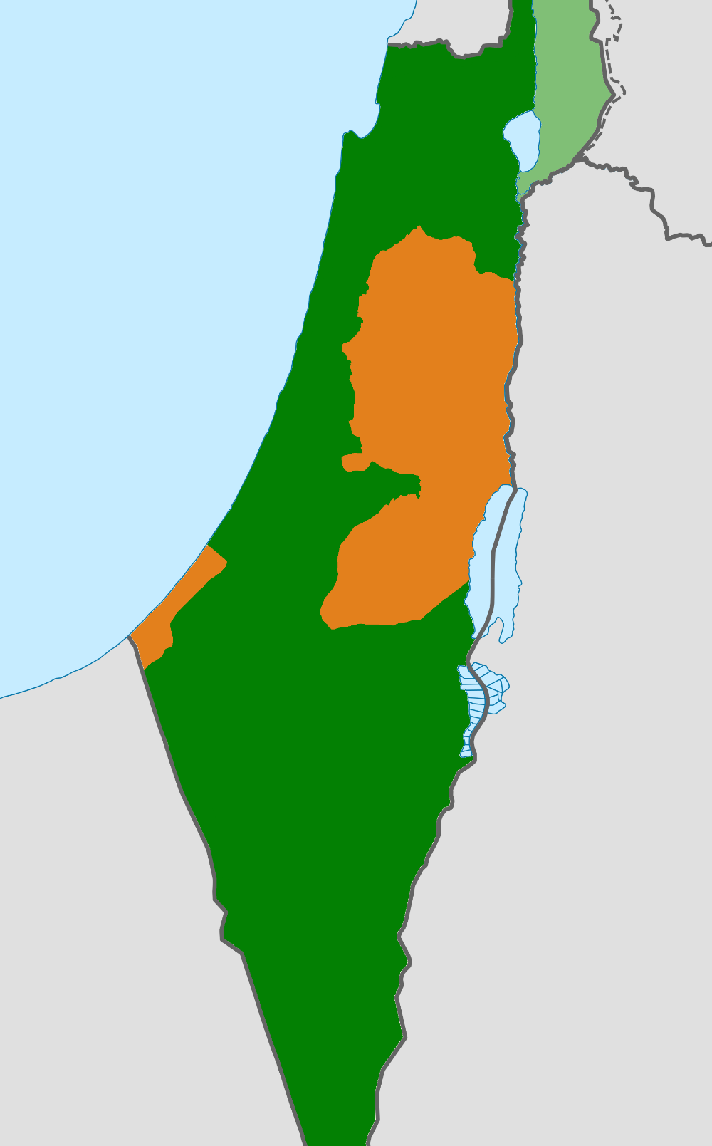
Plenary: in small groups
What 3 things have you learnt today about life for Palestinians inside Israel?

Slide 20
Homework: Exam-Style Question
Explain two consequences of being Palestinian and living in Israel [8 marks]

